Slide 1
0109

Slide 2
Rendering Simple Shapes
Sphere, Cube, Disk, Plane
Ray geometry intersection
How can a shape be defined mathematically? Parametric surface / implicit surface
Intersection of a ray with a sphere

Slide 3
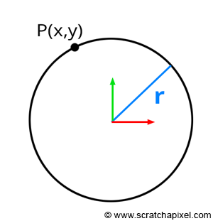
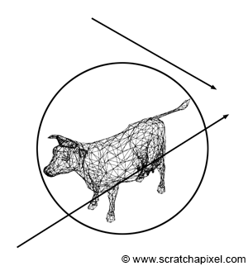
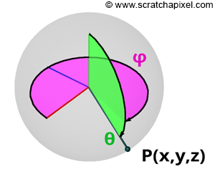


Parametric surcface, Implicit surface
Figure 4: using a sphere as a bounding volume to test whether a ray may intersect the enclosed geometry. If the ray doesn't intersect the sphere, then we know for sure that it can't intersect the object.
θ, ϕ : parameter

Slide 4
